Slide 1

Phishing Simulation Tracker
PHISHING
SIMULATION
TRACKER
A MySQL database that runs phishing campaigns, logs employee responses and automates risk scoring
Presented by:
Tanushree Bali - 1262251830
Pranav Sahoo - 1262250194
Arun S - 1262250907
Neel Mehta - 1262251697

Slide 2


Phishing Simulation Tracker
Project Overview
The Phishing Simulation Tracker is a MySQL database that logs employee clicks and credential entries, then auto-scores risk and locks breached accounts.

Slide 3


Phishing Simulation Tracker
What the system manages
Employees — stores name, role, risk score and account status
Campaigns — stores each phishing campaign and its payload type
Simulation Logs — records link clicks and credential submissions
Automation — one trigger, four stored procedures and a forensic view
Scope & Objective
Objective
To create a structured database that allows an organization to:
Manage employees, roles and risk scores
Create and track campaigns by payload type
Record link clicks and credential submissions
Auto-score risk and lock breached accounts
Audit every incident with a forensic view

Slide 4
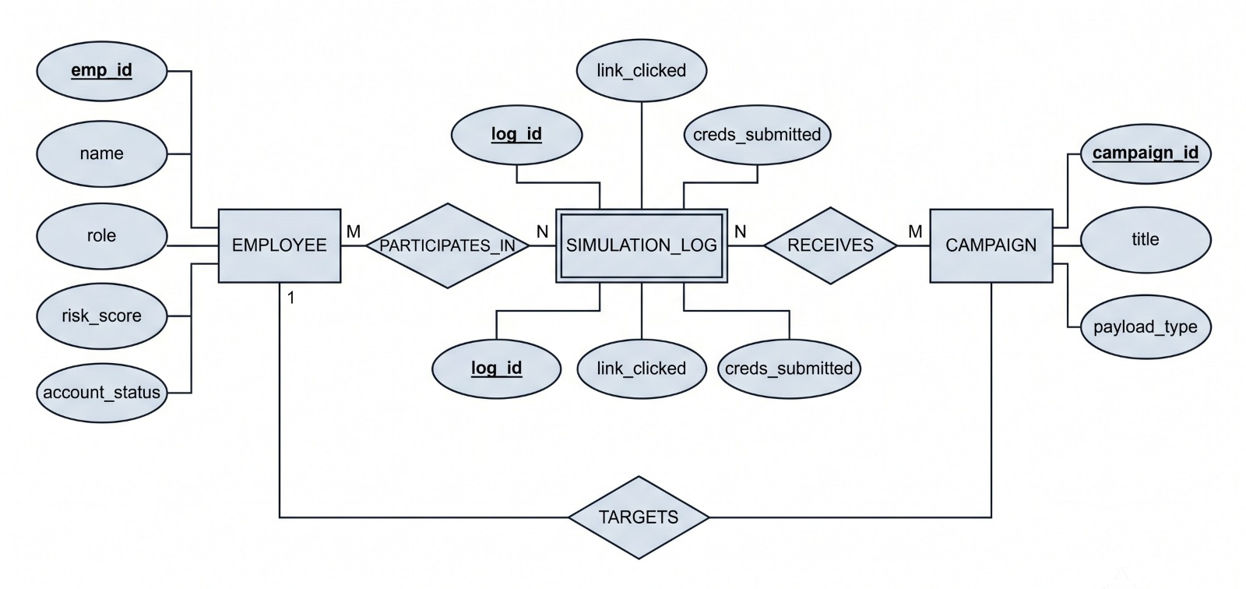
Phishing Simulation Tracker
ER Diagram
Entity Relationship Diagram
Double box: SIMULATION_LOG
Employee M : N Campaign via SIMULATION_LOG
Underlined: primary key

Slide 5
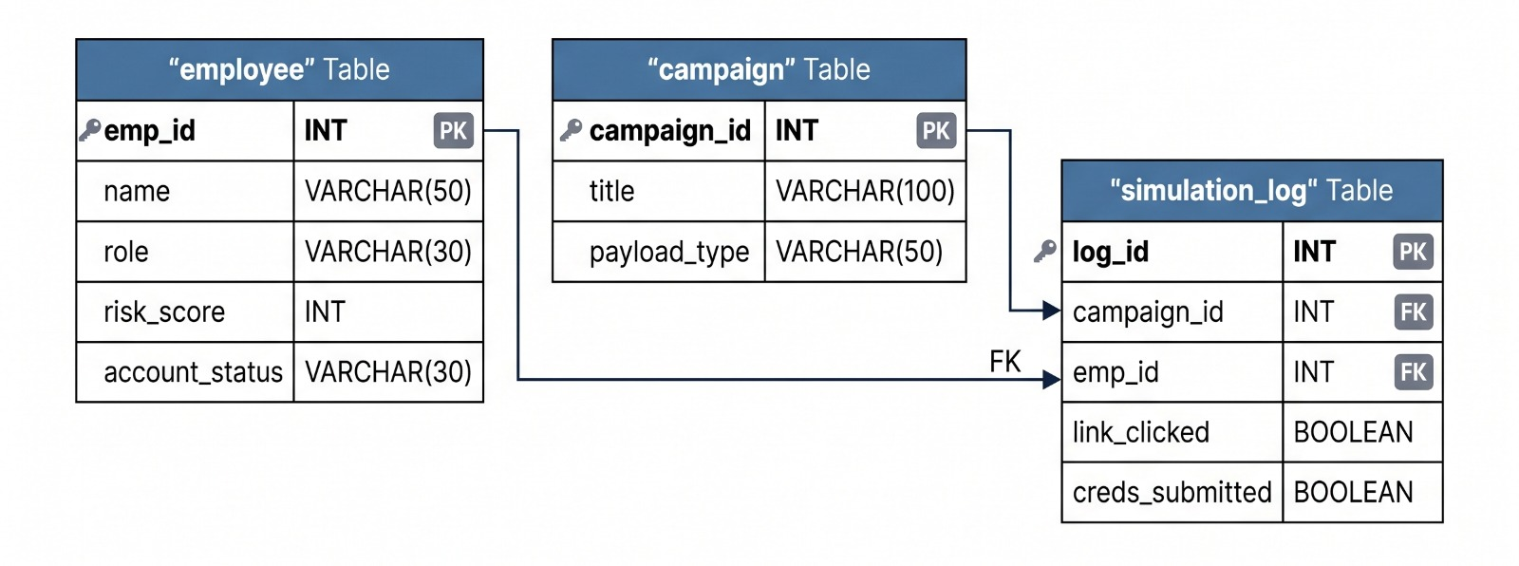
Phishing Simulation Tracker
Relational Schema
Tables, keys and constraints
Keys & Constraints
PK on emp_id, campaign_id and log_id (AUTO_INCREMENT)
FK: simulation_log.emp_id → employee
FK: simulation_log.campaign_id → campaign
UNIQUE (campaign_id, emp_id): one log row per employee per campaign
DEFAULTs: risk_score 0, status ACTIVE, link_clicked and creds_submitted FALSE
Employee 1:M log and Campaign 1:M log, so Employee M:N Campaign
EMPLOYEE(emp_id PK, name, role, risk_score, account_status)
CAMPAIGN(campaign_id PK, title, payload_type)
SIMULATION_LOG(log_id PK, campaign_id FK, emp_id FK, link_clicked, creds_submitted)
FK: emp_id → EMPLOYEE, campaign_id → CAMPAIGN

Slide 6
Phishing Simulation Tracker
Sample Data
Records inserted into cyber_sim
employee
campaign
emp_id | name | role | risk | status
101 | Max | Developer | 0 | ACTIVE
102 | Lewis | Sys Admin | 0 | ACTIVE
103 | Michael | HR Manager | 0 | ACTIVE
104 | Sebastian | Finance Lead | 0 | ACTIVE
105 | Niki | Marketing Exec | 0 | ACTIVE
106 | Ayrton | Sales Rep | 0 | ACTIVE
107 | Charles | Customer Support | 0 | ACTIVE
108 | Fernando | Data Analyst | 0 | ACTIVE
109 | Kimi | Intern | 0 | ACTIVE
110 | Alain | Project Manager | 0 | ACTIVE
id | title | payload_type
1 | Fake IT Update | Credential Harvester
2 | Payroll Document | Malicious Attachment
3 | Free Coffee Promo | Link Click Tracker
4 | Urgent CEO Request | Spear Phishing
5 | Password Expiry | Credential Harvester
Every employee starts at risk_score 0 and account_status ACTIVE.
The trigger updates both as simulations run.

Slide 7
Phishing Simulation Tracker
Trigger: security_monitor
Automatic risk scoring and account lockout
security_monitor
1
Fires AFTER UPDATE
CREATE TRIGGER security_monitor
AFTER UPDATE ON simulation_log
FOR EACH ROW BEGIN
IF NEW.creds_submitted = TRUE
AND OLD.creds_submitted = FALSE THEN
UPDATE employee
SET risk_score = risk_score + 50
WHERE emp_id = NEW.emp_id;
UPDATE employee
SET account_status =
'LOCKED - Breach Detected'
WHERE emp_id = NEW.emp_id
AND risk_score >= 100;
END IF;
END
Runs on every row updated in simulation_log.
2
First credential entry: +50 risk
Only when creds_submitted changes FALSE to TRUE.
3
Score reaches 100: locked
account_status becomes LOCKED - Breach Detected.
Two successful phishes in different campaigns lock the account.

Slide 8
Phishing Simulation Tracker
Stored Procedures
Four procedures that drive the simulation
click_link(target_emp, camp_id)
submit_creds(target_emp, camp_id)
Adds the employee to simulation_log with INSERT IGNORE, sets link_clicked = TRUE and prints a TARGET ACQUIRED message.
Allowed only after a click. Sets creds_submitted = TRUE, which fires the trigger. Otherwise returns ACTION DENIED: sequence error.
Touches: simulation_log
Touches: simulation_log, employee (via trigger)
secops_dashboard()
neutralize_threat(target_emp)
SecOps view of every employee: role, vulnerability score and network access, sorted by risk_score DESC.
Resets risk_score to 0, restores account access and deletes the employee’s simulation_log rows.
Touches: employee (read only)
Touches: employee, simulation_log

Slide 9
Phishing Simulation Tracker
Simulation Workflow
One employee, from first click to reset
Step | Call | Risk | Network access
1 | CALL click_link(101, 1); | 0 | ACTIVE
2 | CALL submit_creds(101, 1); | 50 | ACTIVE
3 | CALL click_link(101, 5); | 50 | ACTIVE
4 | CALL submit_creds(101, 5); | 100 | LOCKED - Breach Detected
5 | CALL neutralize_threat(101); | 0 | active
forensic_audit_log
A VIEW joining simulation_log, employee and campaign.
Lists only rows where link_clicked = TRUE, newest first.
Columns: incident_id, target_name, department, attack_vector, payload.
Aliases: link_clicked → link_compromised, creds_submitted → data_exfiltrated.
Sample terminal_output
>>> TARGET ACQUIRED: employee 101
>>> Connection established to payload...
>>> Awaiting credential input...
>>> ACTION DENIED: sequence error. (submit before click)
SELECT * FROM forensic_audit_log;

Slide 10
Phishing Simulation Tracker
SQL Queries & Data Retrieval
Reading the simulation tables and the forensic view
Simulation Tracking
Basic Data Retrieval
The SIMULATION_LOG table records the result of each phishing simulation.
Tracked Information
Link Clicked — whether the employee clicked the simulated link
Creds Submitted — whether credentials were entered
Campaign — which phishing campaign was used
Employee — which employee participated
SELECT * FROM employee;
SELECT * FROM campaign;
SELECT * FROM simulation_log;
SELECT * FROM forensic_audit_log;

Slide 11

Phishing Simulation Tracker
DBMS Concepts & Conclusion
What the project demonstrates and where it goes next
DBMS Concepts Demonstrated
Future Scope
Conclusion
Relational Database Design
Primary & Foreign Keys
Composite UNIQUE Constraint
DEFAULT Values & AUTO_INCREMENT
Triggers (AFTER UPDATE)
Stored Procedures (IN params)
Views
JOIN Operations
INSERT IGNORE
Conditional Logic (IF / ELSE)
Aggregate Function COUNT()
Data Retrieval using SELECT
Training plans for high-risk staff
Campaign performance dashboard
Automated email campaign integration
Role-based access for SecOps
Historical campaign analysis
The Phishing Simulation Tracker manages phishing awareness campaigns, logs employee responses and scores risk automatically.
A trigger and stored procedures turn each click and credential entry into a risk score, lock breached accounts and let SecOps review or reset them.

Slide 12

Phishing Simulation Tracker
Thank You
For Your Attention

